Slide 1


GIT & GITHUB

Slide 2
Table of Contents
What is GIT
What is version control system
Why version control
Why to use git
Setup the git
Lifecycle of file in git

Slide 3
Table of Contents
Git basic commands
Switch to GitHub
Difference between git and GitHub
Who uses the GitHub
Control GitHub using git

Slide 4
GIT
A distributed version control system

Slide 5
Version control systems
Version control or revision control, or source control
It is all about managing multiple versions of documents, programs, web-sites, etc.
Almost all “real” projects use some kind of version control.
Essential for team projects, but also very useful for individual projects.

Slide 6
Why version control?
Share folders and documents with team
See teammate’s work and do comparison
Reuse modules from previous work
Use same shared folders for

Slide 7
Distributed Version Controller - Git
What is Git?
Untracked Files, Staging and Committing
Life Cycle of a file in Git

Slide 8
Setup for Git
Install Git and Git Bash
Environment Variable PATH
Install Git GUI(optional)
- bit.ly/gitsetup
git config --global user.name “yourName”
Git config --global user.email “your@mail.in”

Slide 9
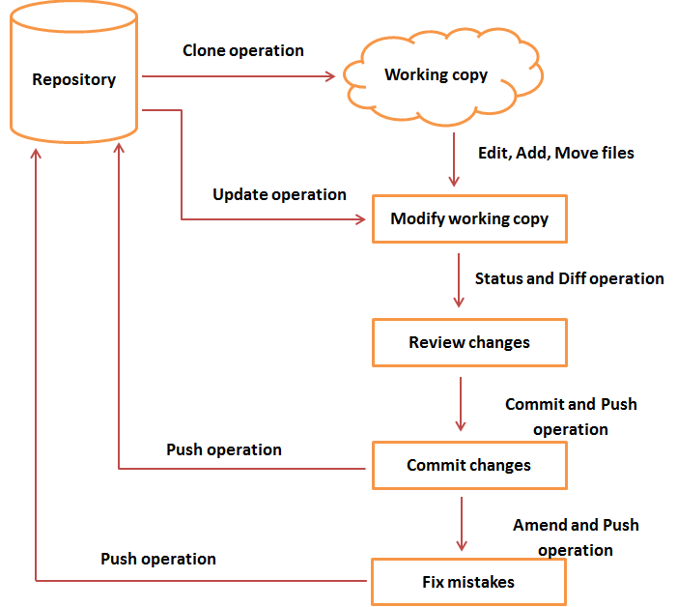
Life cycle of file in Git

Slide 10
Initialize the repository
What is a repository?
Initialize a local repo
Command: git init

Slide 11
Git add
Let create an html page
Now put the file into staging
What is staging
Command: git add filename.txt

Slide 12
Git commit
Now commit all your work
Command: git commit –m “Message”

Slide 13
Repeat...
….
Add some files
Do git add and git commit
….

Slide 14
Git status
Check your work status since last commit
Untracked files
Added / Deleted / Updated files

Slide 15
Git log
View previously committed work
How messages helps here
What do that random text mean?

Slide 16
Git push
Wanna get same files from office desk to personal laptop?
How to put same git repo online?
Git remote add <location>

Slide 17
Git clone <location>
Get same repo from the server or online storage
Get upto all latest commits

Slide 18
...Repeat....
Add new stuff
Git add .
Git commit -m “Added new module From Home”
Git push

Slide 19
Git pull
You are back to office and need work you did from home?
Get all data upto last commit from remote repo

Slide 20
Git fetch
Need remote data to local machine, but do not want to be added to your working directory?

Slide 21
.gitignore
A file that contains list of files that do not require versioning
For example .class, .private, external libraries etc.

Slide 22
readme.md
Describe your repo here

Slide 23
Github
What is Github?
Features of github
Role of Github for individuals, groups/teams and business

Slide 24
Setup Github Account
Login/SignUp
Concept of public and private repo
Create new repo

Slide 25
Clone from Github
Clone newly created repo from github
Or
Get already existing local git repo on Github

Slide 26
...Repeat...
Add new stuff
Git add .
Git commit -m <message>
Git push

Slide 27
Git stash
Did some changes and getting too much errors?
Go back to last commit

Slide 28
Branch
What is branch in version control?
Advantages of branching
Concept of master branch

Slide 29
Git branch
List all available branches available at local machine
Git branch --all : local + remote branches

Slide 30
Git branch <newbranch>
Create new branch

Slide 31
Git checkout <branchname>
What do checkout mean?
Effect of checkout on single file
Let go to newly created branch

Slide 32
...Repeat...
Add new stuff
Git add .
Git commit -m <message>
Git --set-upstream
Git push

Slide 33
Git merge
Once completed all work related to this branch?
Add this work to master branch so that it can go live for production environment
What is conflict?
How to handle conflicts during git merge?
Once branch is not required - delete the branch : git branch -d <name>

Slide 34
Revision
Git clone/init
Git add/commit
Git push/pull/fetch
Git status/log/stash
Git branch/checkout

Slide 35
Any Questions?
Thank you

